Slide 1
Ukiyo-e Style Generator Based on DCGAN
Hang Wang
Yi Nie
Introductor: Prof.Jin
Github Link:
https://github.com/HangWang2025/Stat6289/blob/main/Final_Member1_Wang_Hang_Member2_Nie_Yi.ipynb

Slide 2
What’s difference between GAN and DCGAN?
For Generator:
· No pooling layer.
· Use deconvolution layers for sampling.
· Batch normalization.
· No full-connected layer.
· Use ReLu function as activate function. (tahn function in the output layer. )
For Discriminator:
· No pooling layer.
· Replace pooling with the convolution added stride.
· Batch normalization.
· No full-connected layer.
· Use LeakyReLu function as activate function.

Slide 3
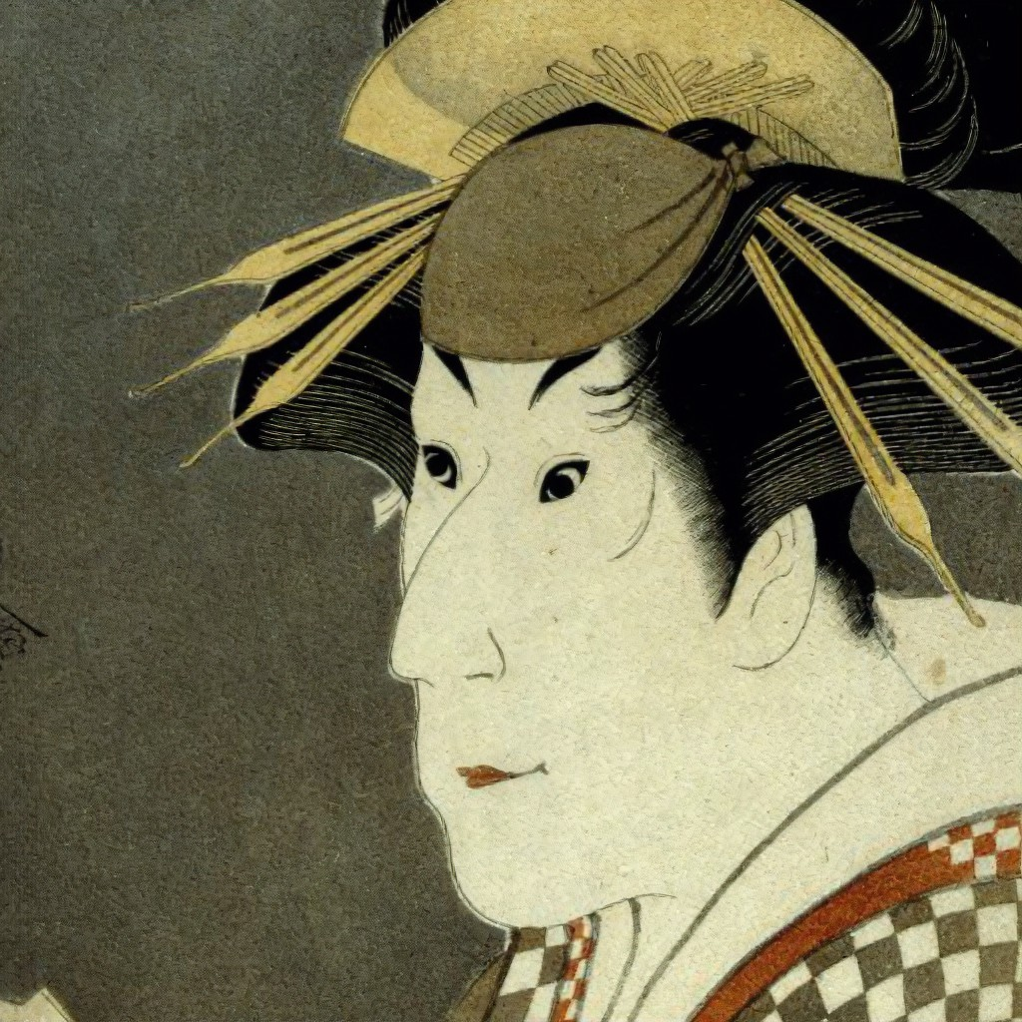
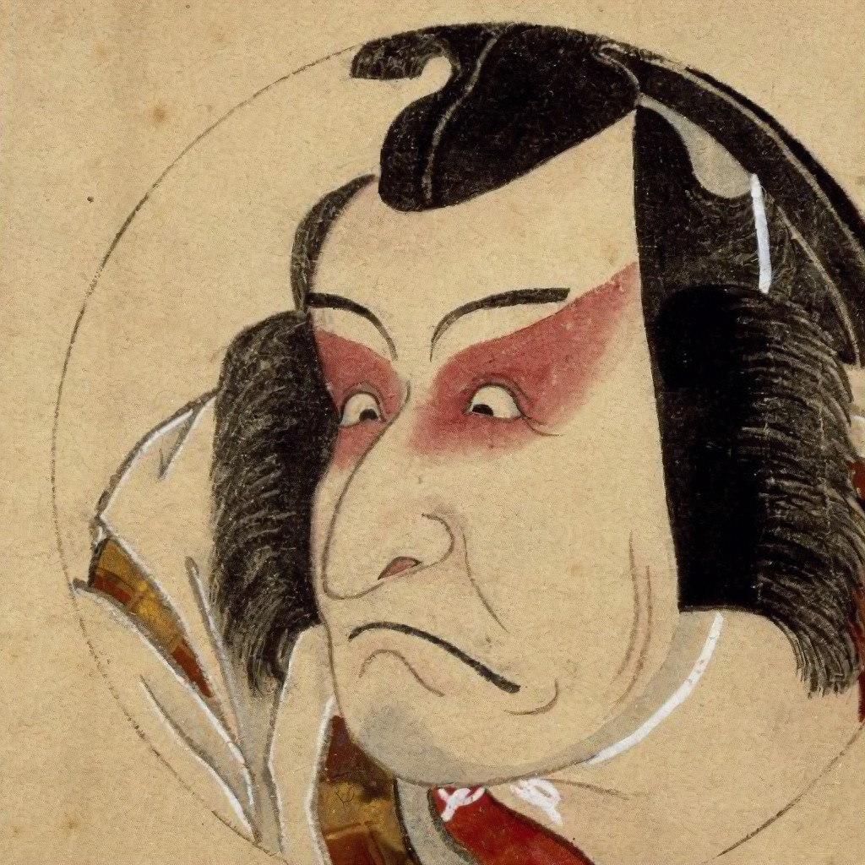
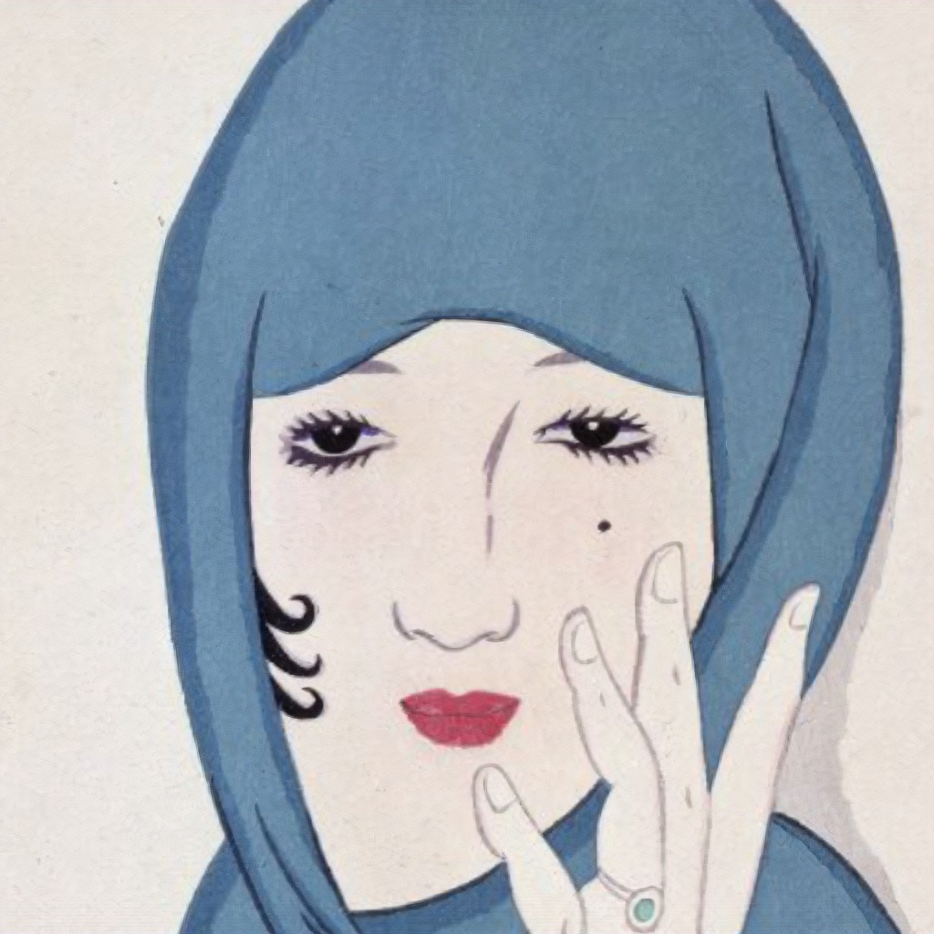
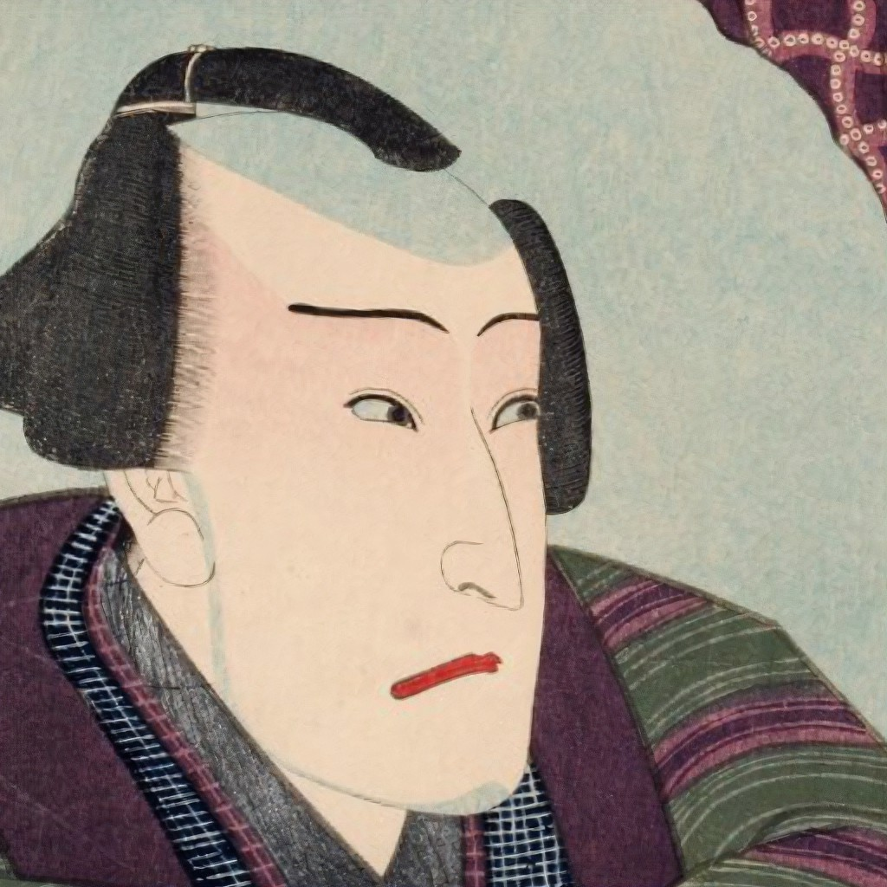
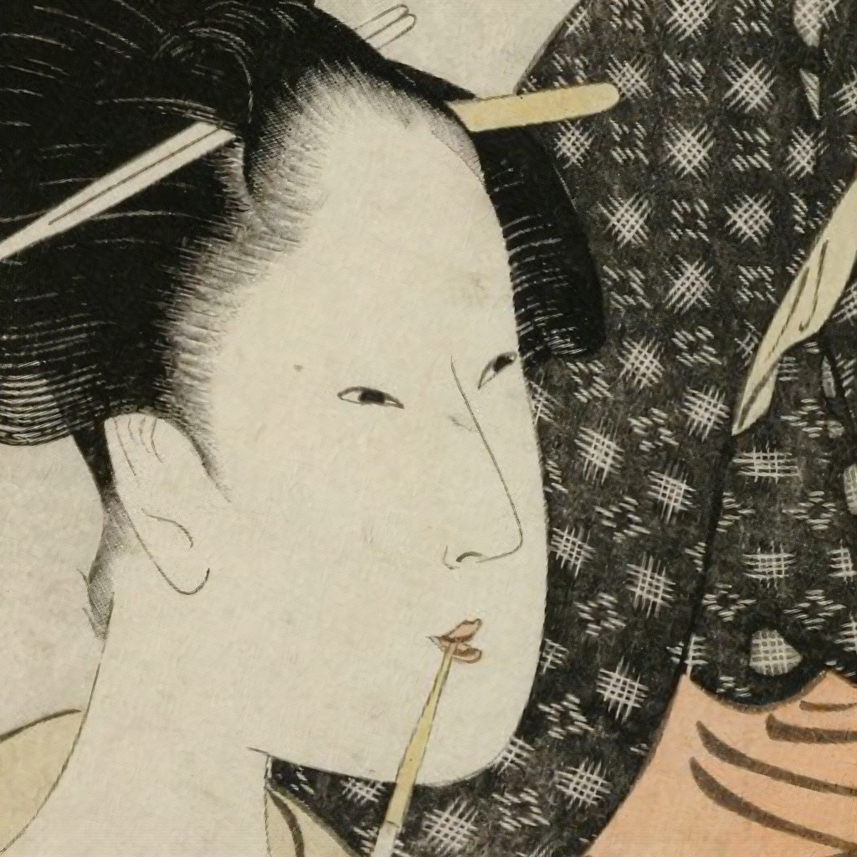
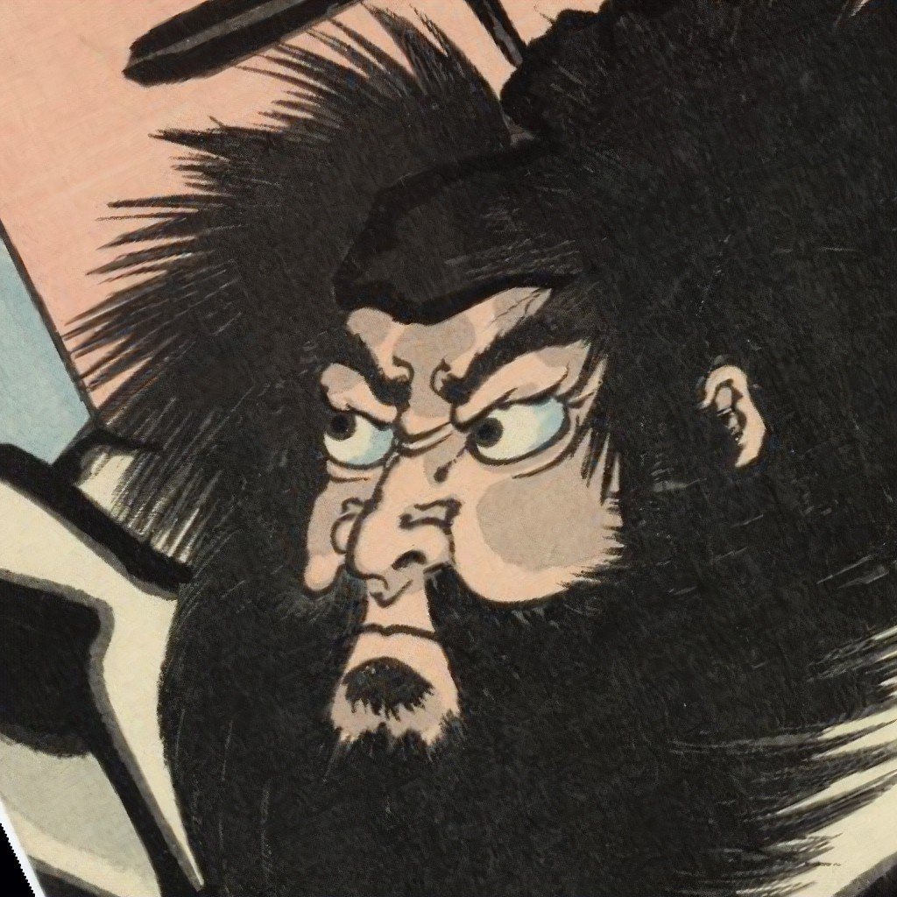
Real Pictures
In the dataset, there are 5209 real ukiyo-e pictures with size of 1024×1024.
When collecting the dataset, the noses of all the characters are in the center.

Slide 4
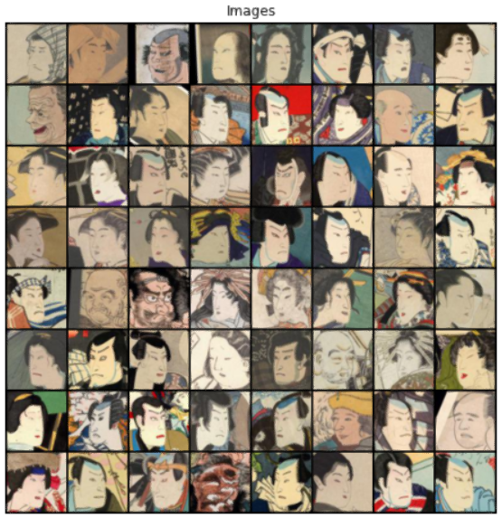
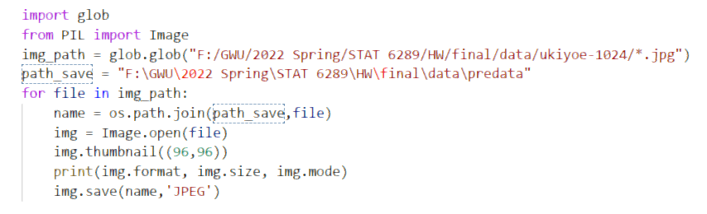
Data Processing
In order to reduce the time consumption, we batch process the size of 5209 pictures to 96×96.

Slide 5
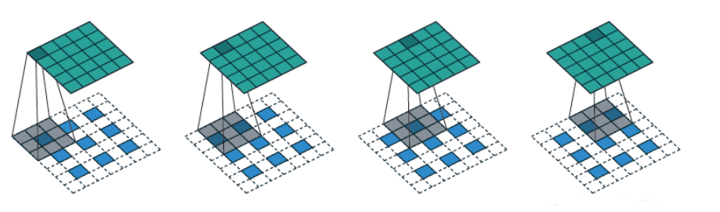

Deconvolution
Step 1: Perform some transformations on the input feature graph A to obtain the new feature graph A '.
Step 2: Find the new convolution kernel setting and get the new convolution kernel setting, which will be distinguished by adding the apostrophe in the upper right corner
Step 3: perform conventional convolution on the new feature graph with the new convolution kernel, and the result is the result of the inverse convolution, which is the result we want.

Slide 6
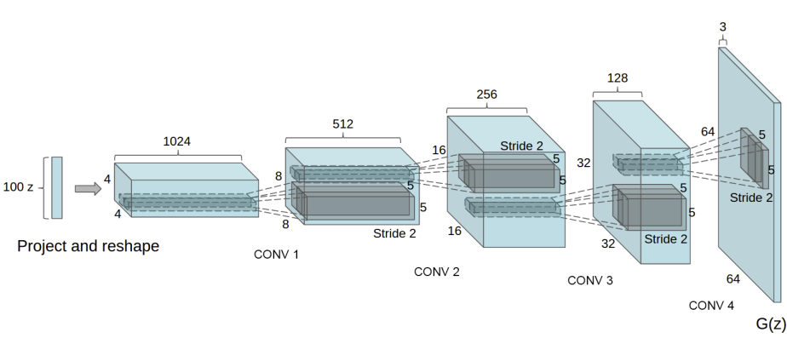

Generator
Structure
—DCGAN
64
128
512
256
kernel size = 4
stride size = 2
padding = 0
kernel size = 4
stride size = 2
padding = 1
kernel size = 4
stride size = 2
padding = 1
kernel size = 4
stride size = 2
padding = 1
kernel size = 4
stride size = 2
padding = 1

Slide 7
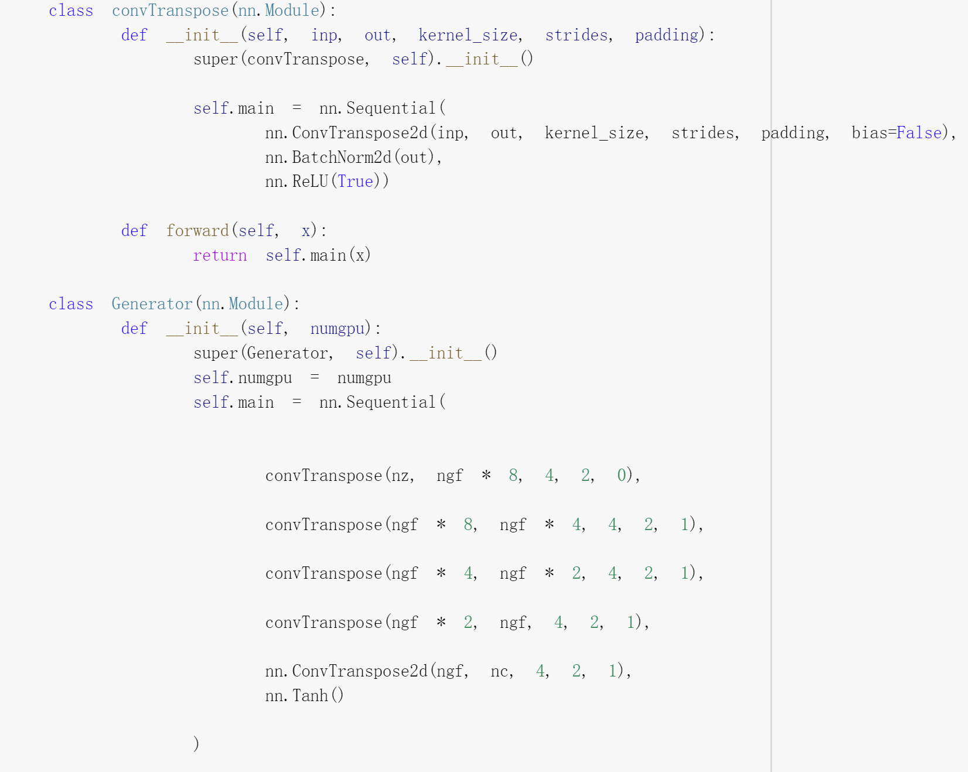
Generator
For generator part, we change the in-channel size in first deconvolution part from 1024 to 512, compared with original paper. The kernel size chooses 4*4 in all deconvolution steps rather than 5*5. After 5 deconvolution, we use Tanh as activate function.

Slide 8
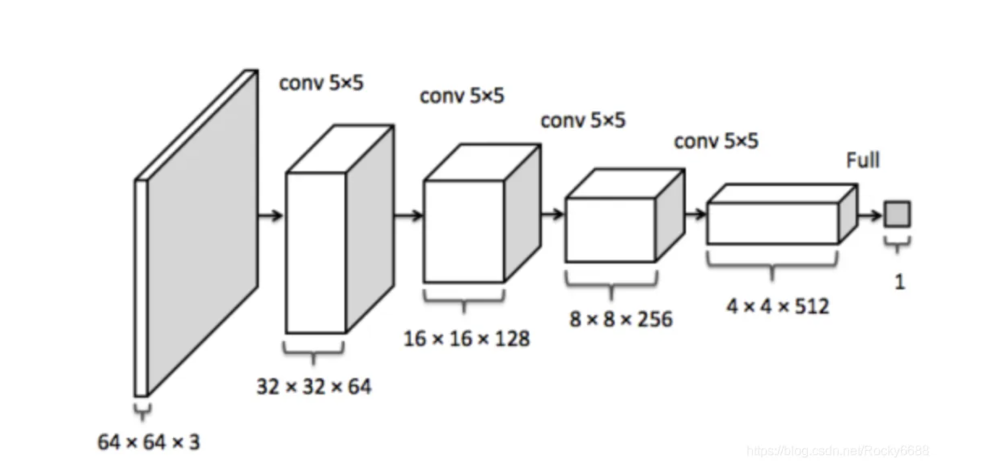
Discriminator
Structure
—DCGAN
kernel size = 4
stride size = 2
padding = 1
kernel size = 4
stride size = 2
padding = 1
kernel size = 4
stride size = 2
padding = 1
kernel size = 4
stride size = 2
padding = 1
kernel size = 4
stride size = 2
padding = 0

Slide 9
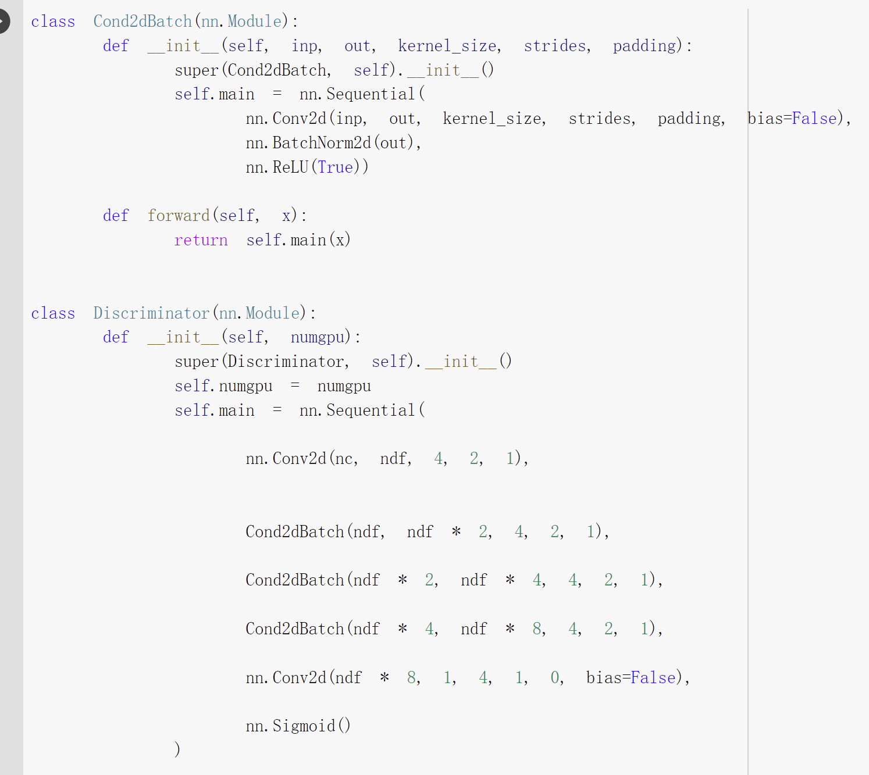
Discriminator
Discriminator of DCGAN is almost the same as a reverse of Generator part. The most different part is the activate function which used relu and sigmoid.

Slide 10
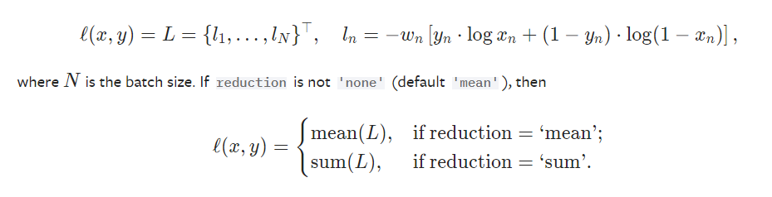

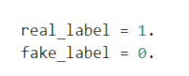
DCGAN Structure
We use the binary cross entropy loss (BCE Loss) function defined in PyTorch.
Loss
Function
Define the true tag as 1 and the false tag as 0.
Finally, we set up two separate optimizers, one for D and one for G. As described in DCGAN's paper, both of these are Adam optimizers with learning rates of 0.0002 and Beta1=0.5.

Slide 11
We set the epoch = 100.
To track the generator's learning progress, we generate a fixed set of potential vectors from a Gaussian distribution (that is, fixed noise).
During the training process, we periodically input this fixed noise into G.
Also we have set batch size equals 512 and 256, then draw the loss during training process as the iteration increases.
Training

Slide 12
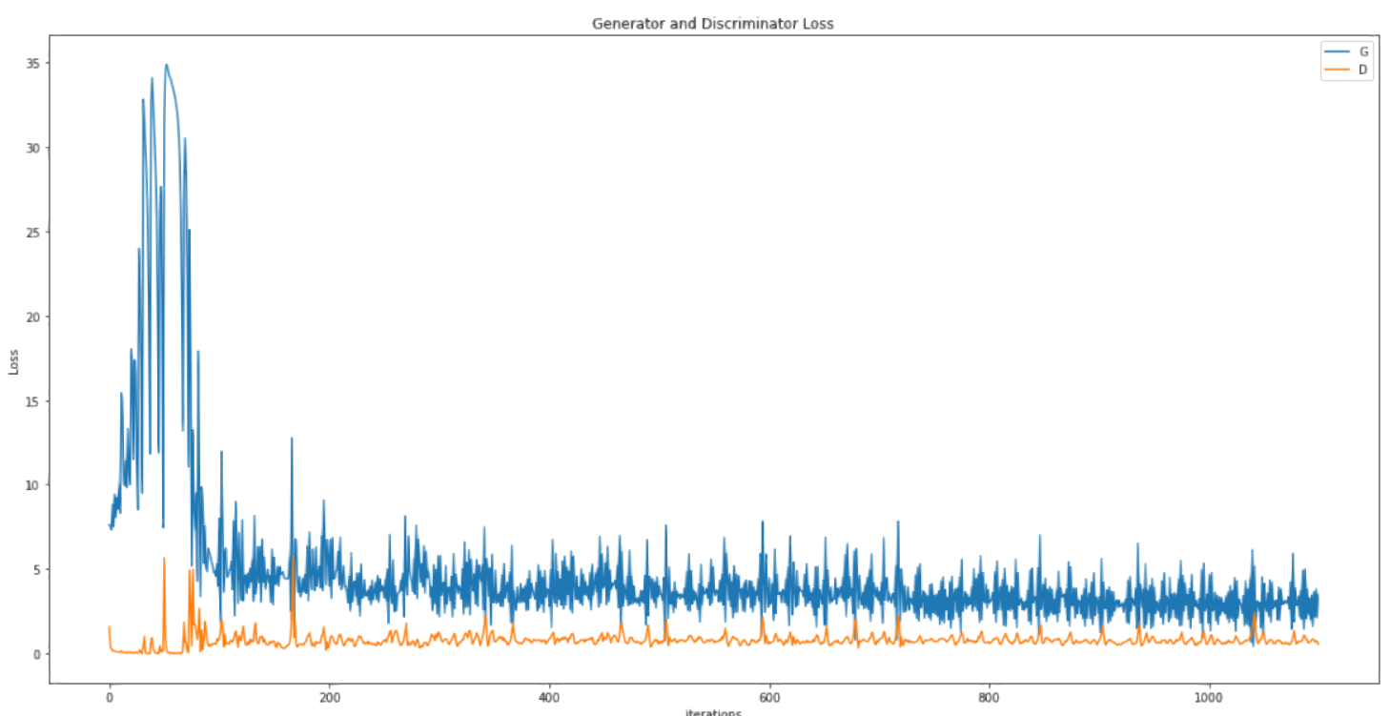
Batch Size = 512

Slide 13
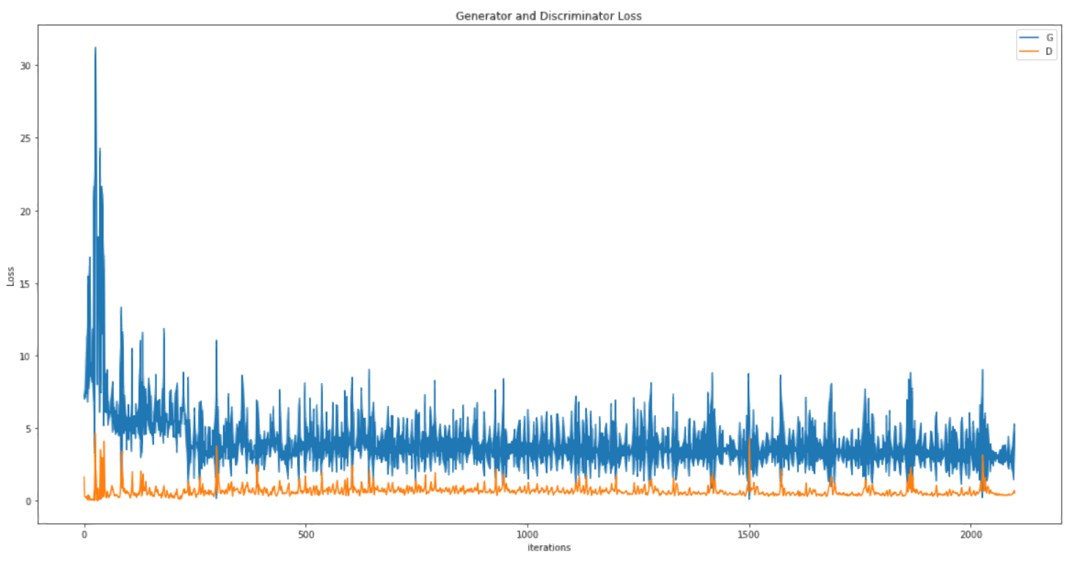
Batch Size = 256
Compared with former plots, we find the loss of model with batch size = 256 is lower.

Slide 14
DCGAN Structure
Generator
Samples
In this part, we show some sample images from generator during the training process.

Slide 15
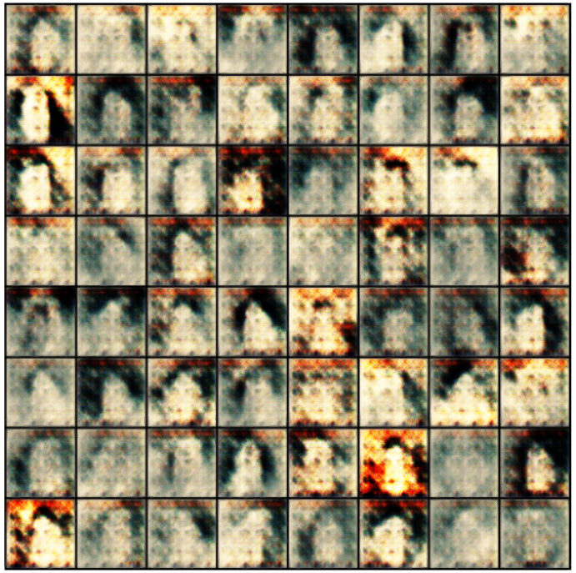
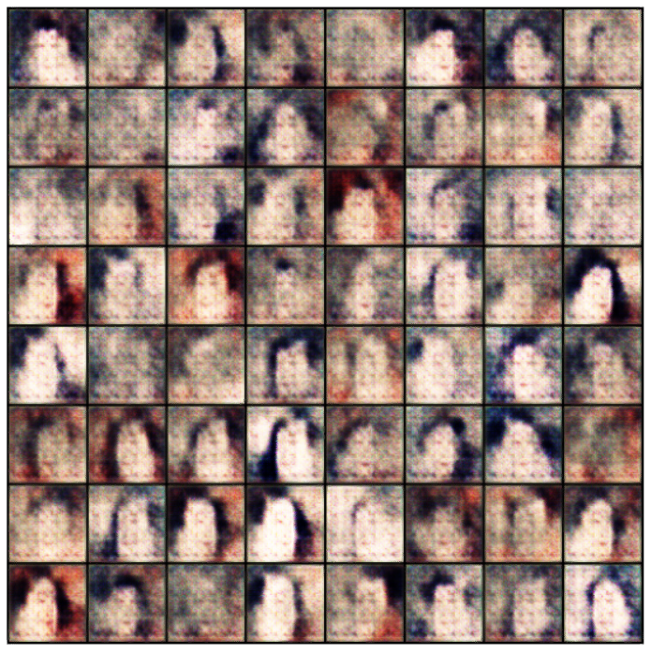
Batch size = 512 Batch size = 256

Slide 16
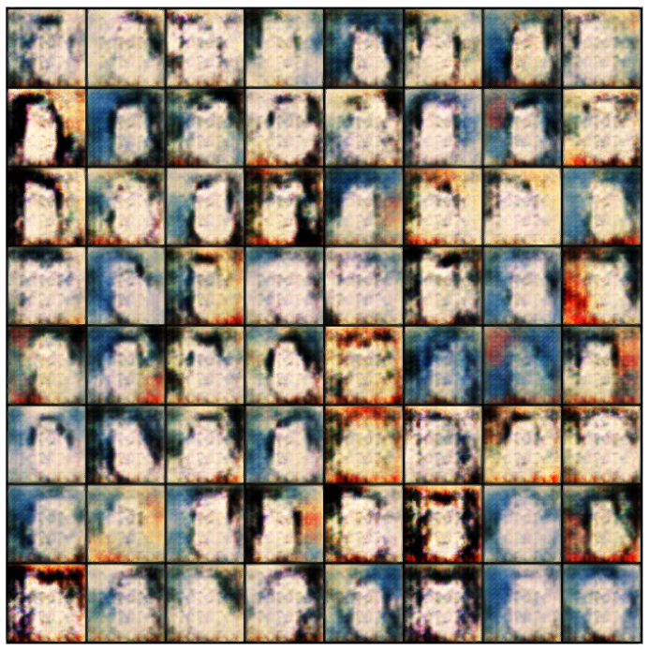
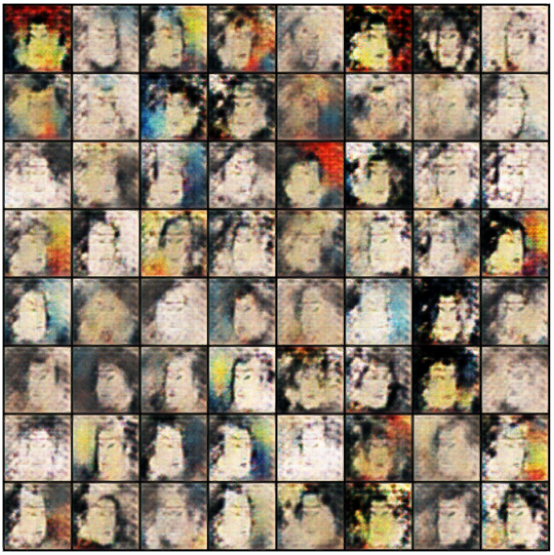
Batch size = 512 Batch size = 256

Slide 17
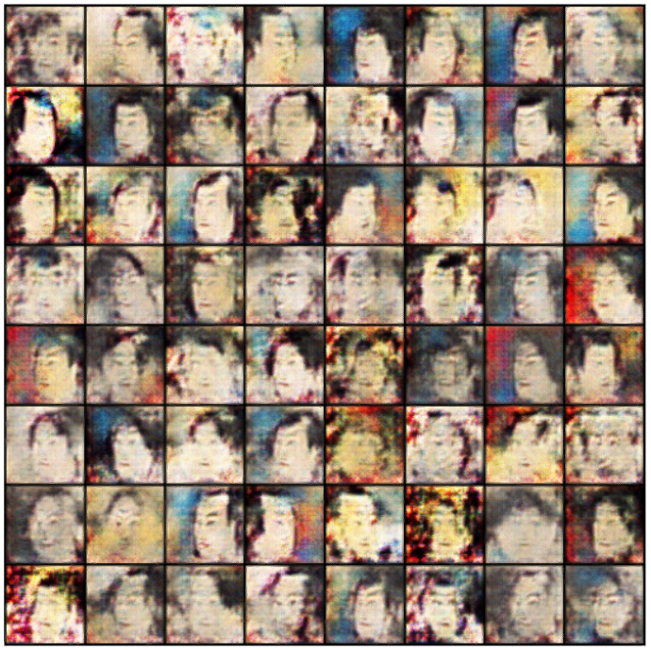
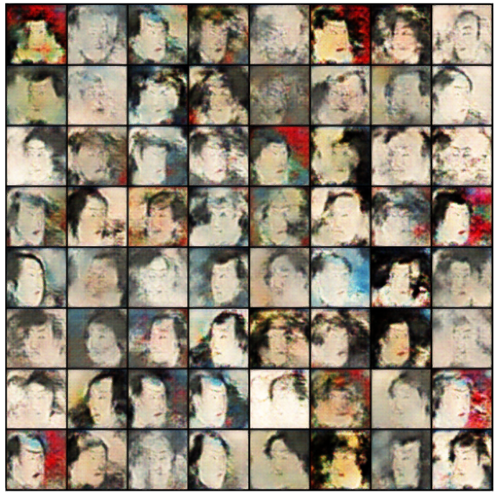
Batch size = 512 Batch size = 256

Slide 18
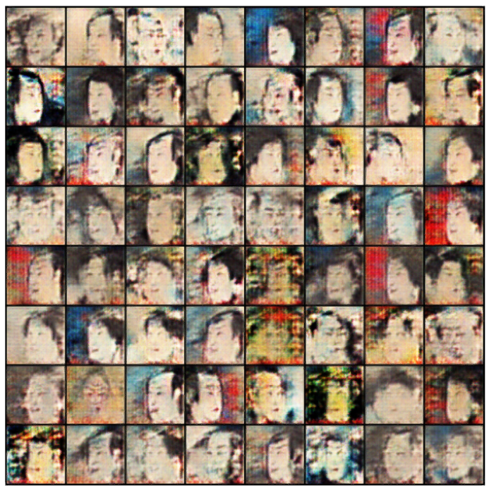
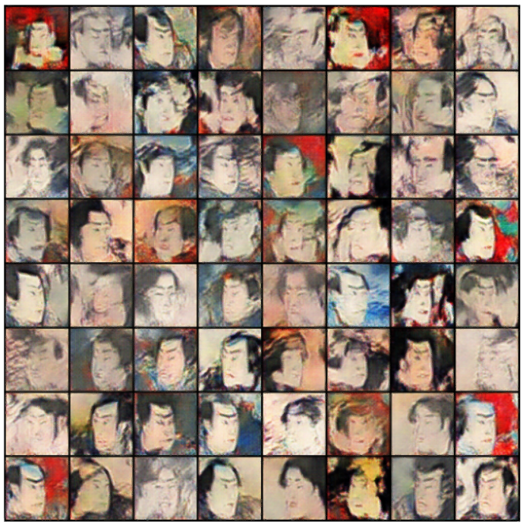
Batch size = 512 Batch size = 256
Just as the former loss function plots, the model trained with batch size = 256 has better generating results.

Slide 19
Contribution
Each member put forward various interesting ideas, searched literatures attentively, and actively participated in the topic selection. We worked together almost in the whole process of final project, including making slides.
Yi was mainly responsible for collecting the data set, batch processing of image sizes, importing the images, and making the poster.
Hang was mainly responsible for debugging the main part of model, training model and organizing the generated images from generator.

Slide 20
What we have learned?
Use Pillow packages to import or batch process pictures with .jpg type. We learned to batch process 5209 pictures into size that our computers are able to handle.
The concept of Transposed Convolution (Deconvolution). This is a new concept for based on convolution.
Implementation of Generative Adversarial Network(GANs). Finally we generate our own ukiyo-e pictures.
Various implementations of GANs, though it doesn’t present in our projects.

Slide 21
Thanks for watching!

